Slide 1


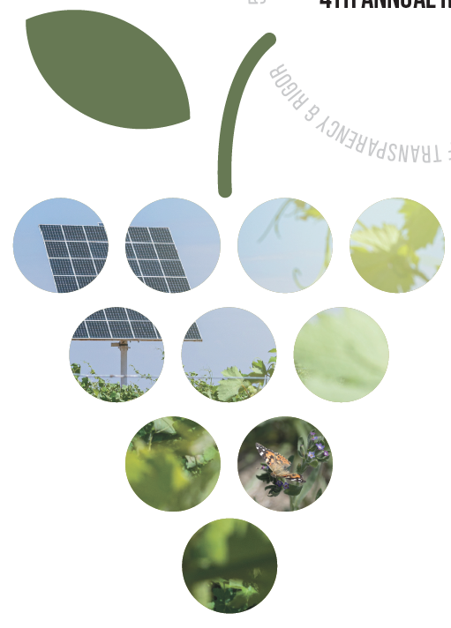

International Wineries for Climate Action
Compilation of Soil Organic Carbon (SOC) Sequestration Projects
July 2025
Filling instructions:
Complete all fields and do not remove any of them.
Keep all the necessary information on one page.
The size of the boxes and letters can be adjusted according to your needs if they do not impair the legibility of any of the other boxes.
Information can be inserted making use of tables and logos.
Please send your project in ppt format to IWCA.
For additional information, please refer to the "IWCA SOC Compilation Project Charter" document
Disclaimer: The wineries participating to the SOC Sequestration Compilation must make sure that the information shared with IWCA for this specific project is not confidential, and can be shared, exposed, printed without any harm to themselves or any other third parties. IWCA is not responsible for the data shared on behalf of the wineries.
Leading the transition to a
global wine sector

Slide 2

 | COMPILATION OF SOIL ORGANIC CARBON (SOC) SEQUESTRATION PROJECTS IN VINEYARDS |  |  | Presented by: (Winery Logo)
Project Name: (input here) Website Project: (input here) |  |  |  | Location: (Country, Region)
Project Description & Goal: (input here) context |  |  | Project Members: (input here: are there other wineries or partners?)
Project Start Date: MM/YYYY Project End Date: MM/YYYY |  | Date of slide edition MM/DD/YYYY Person in charge: (Name, role, and contact information)
Soil Carbon Sequestration Calculation Methodology: Please detail, at least Frequency of sample: (annual, biennial) Number of samples per hectare or plot Depth of samples sampling tool/method sample repetition for statistical matters Other details (for example: type of soil and climate conditions, average annual production, years of life, management, etc).
Conclusions: (input here, if there are scientific publications, Soil Organic Carbon (SOC) sequestration Sources: data results (Mg CO₂eq /ha/year), and the paper’s link, in case.
Internal use: Project number

